Slide 1


Wishing you a Very Happy Holiday Season!
The Christmas Family
Wishing you a Very Happy Holiday Season!
The Christmas Family
Notes:
Want a different greeting? To add your own, just select the text and enter your message. To replace a picture, just select and delete it. Then use the Insert Picture icon to replace it with one of your own!
Or, if you'd rather start from a clean slate, press the New Slide button on the Home tab to insert a new page. Now enter your text in the empty placeholders.

Slide 2


Wishing you a Very Happy Holiday Season!
The Christmas Family
Wishing you a Very Happy Holiday Season!
The Christmas Family

Slide 3
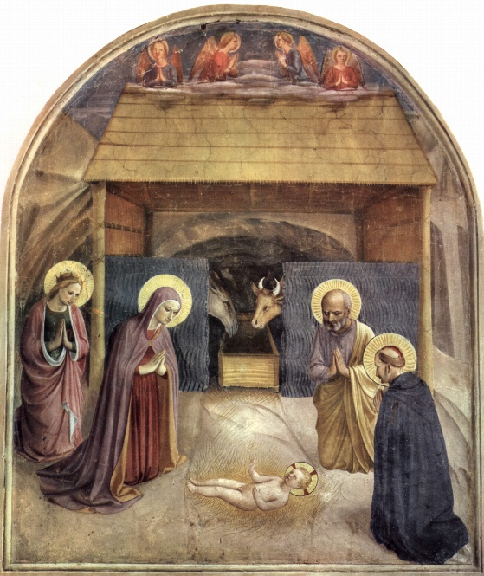
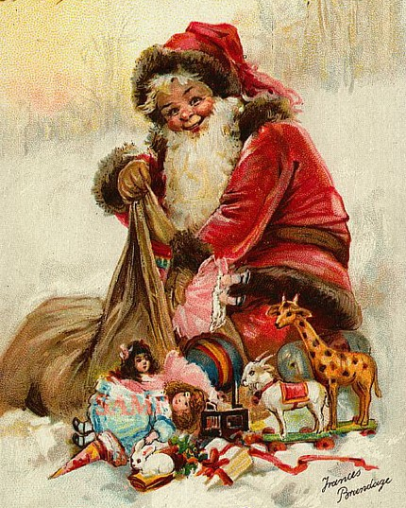
Wishing you a Very Happy Holiday Season!
The Christmas Family
Wishing you a Very Happy Holiday Season!
The Christmas Family

