Slide 1
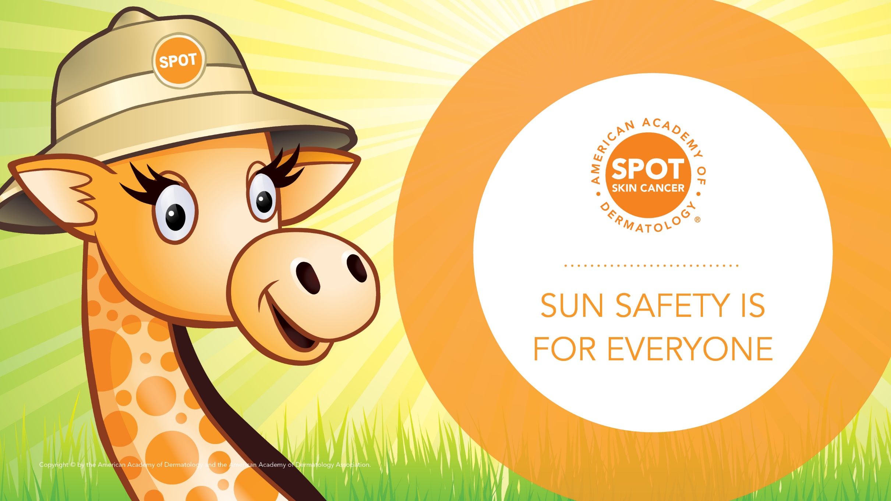
Notes:
Thank you for letting me visit with you today. I’m Doctor (NAME) from (INSTITUTE/PRACTICE NAME) and I’m a dermatologist. Does anyone here know what a dermatologist is? (Pause for answers.) A dermatologist is a doctor who cares for your skin, hair and nails. Today, I’m here to talk about how to protect yourself from the sun.

Slide 2
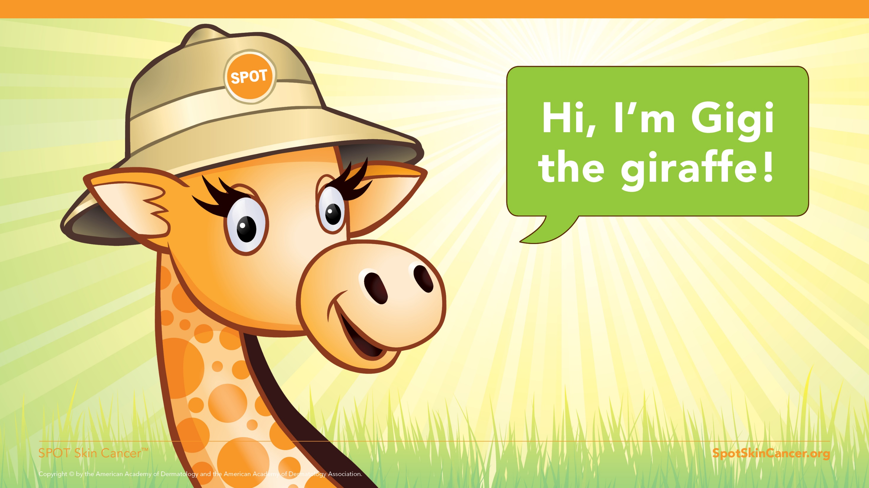
Notes:
This is my friend Gigi the Giraffe and she is here to help me tell you about the importance of sun protection.

Slide 3
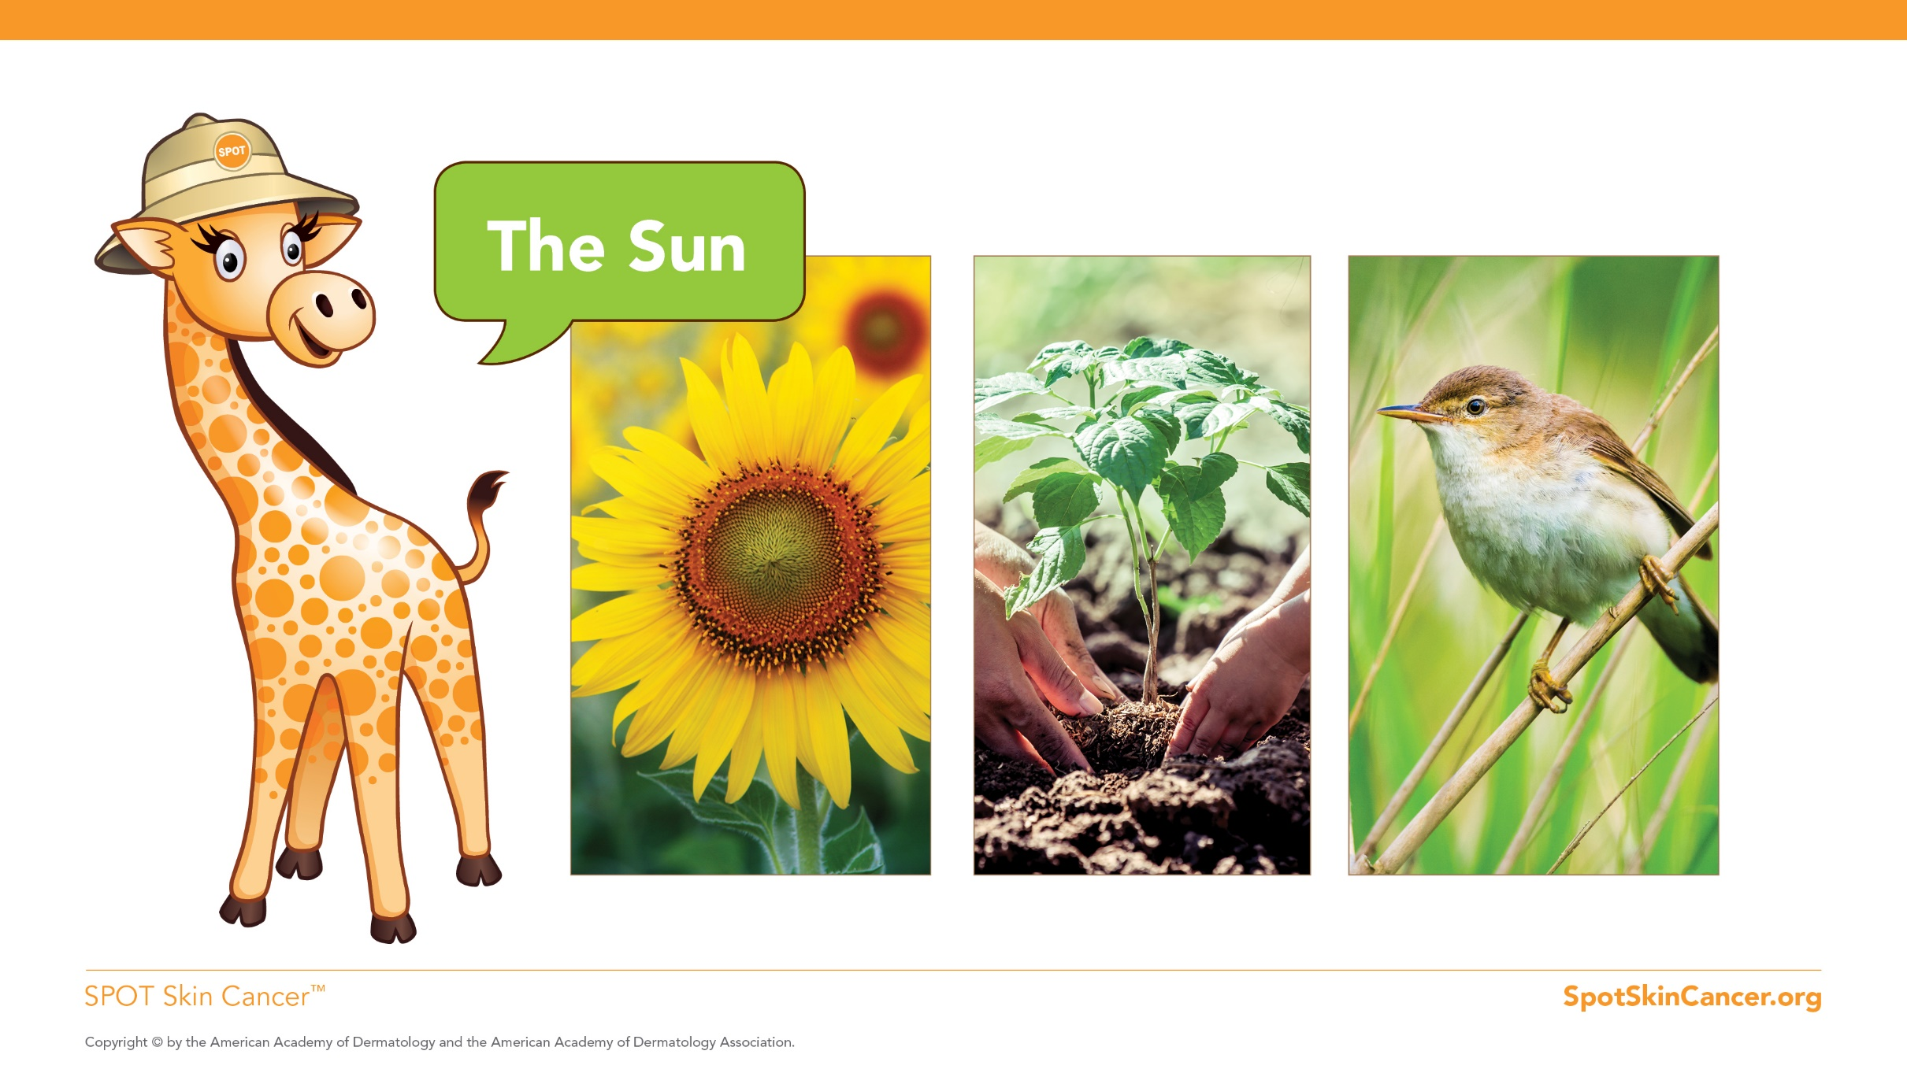
Notes:
What do we know about the sun? (Pause for answers such as the sun is good for the flowers, trees, birds, etc.)

Slide 4
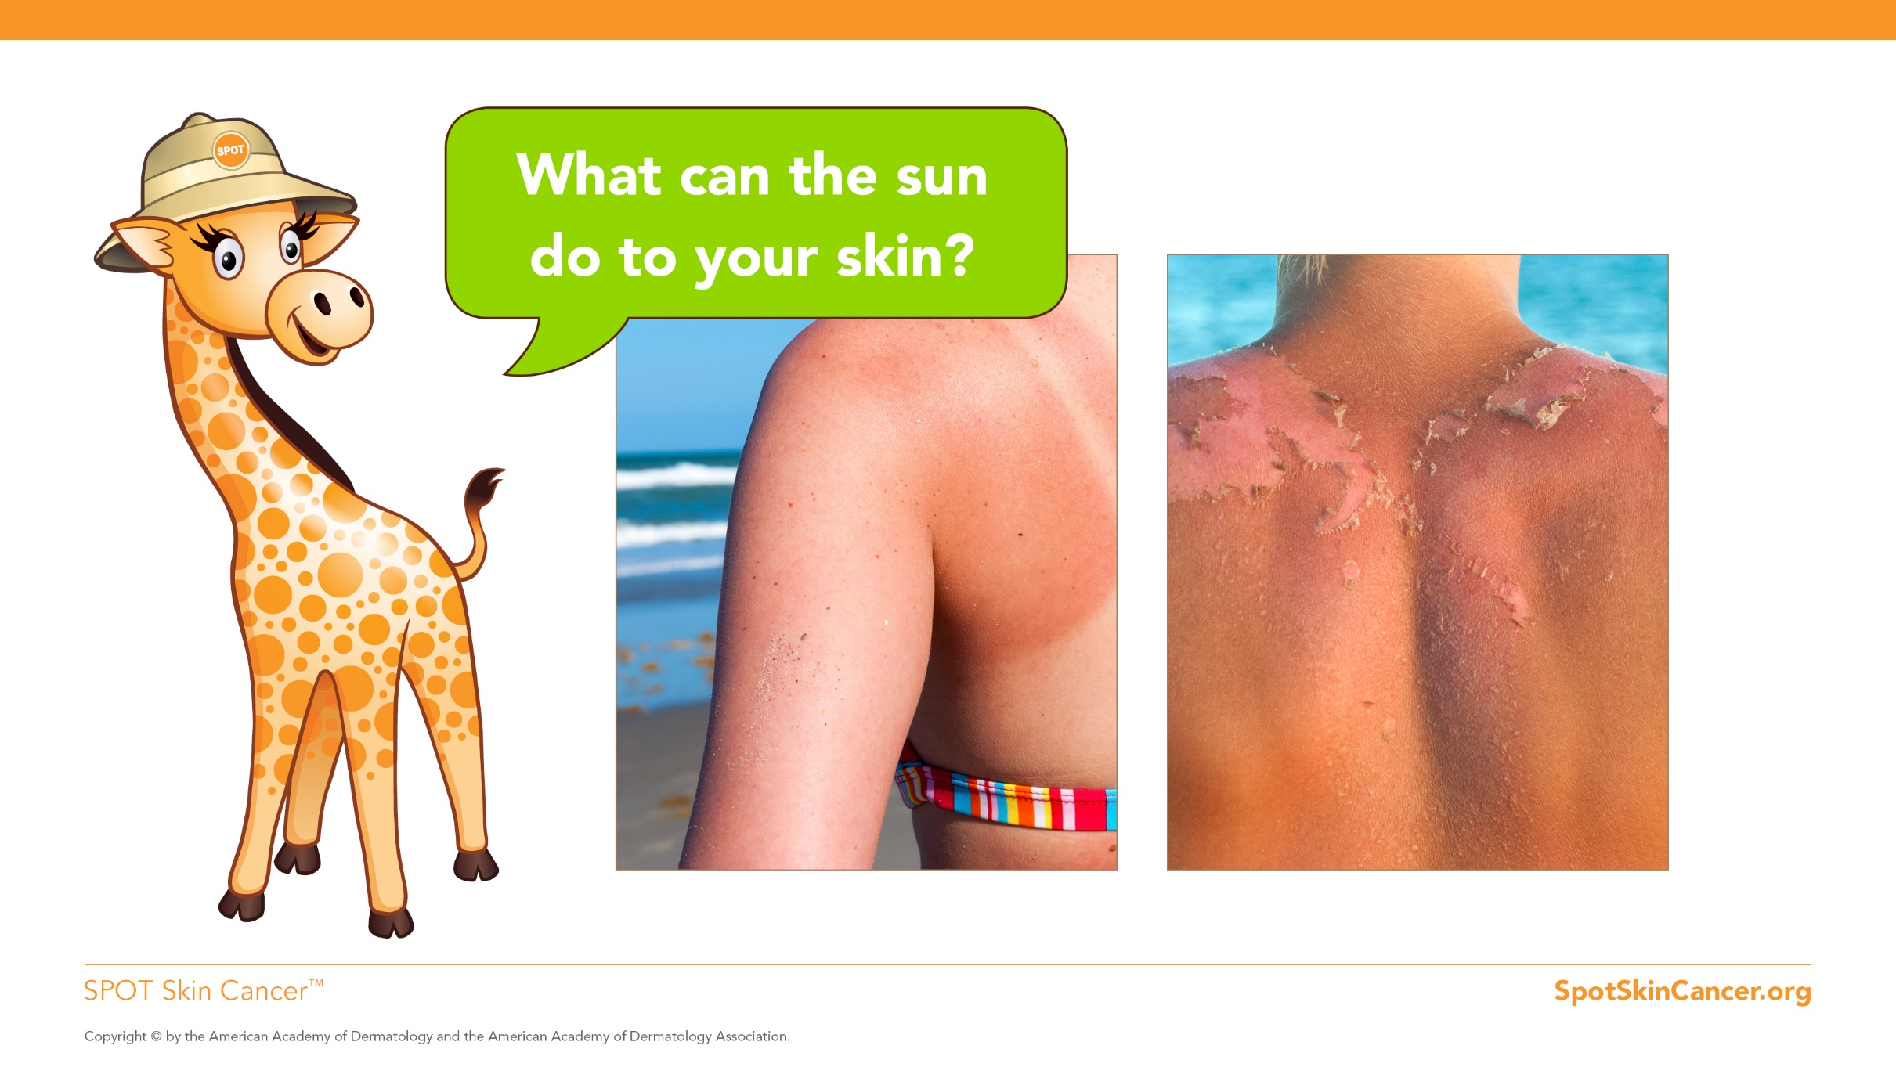
Notes:
How many of you have had a sunburn? (Pause for answers/hands raised). I bet that hurt, right? You probably tried really hard next time you were outside to not get a sunburn. Any time your skin is not protected by sunscreen or clothes and you get too much sun, it can burn.

Slide 5
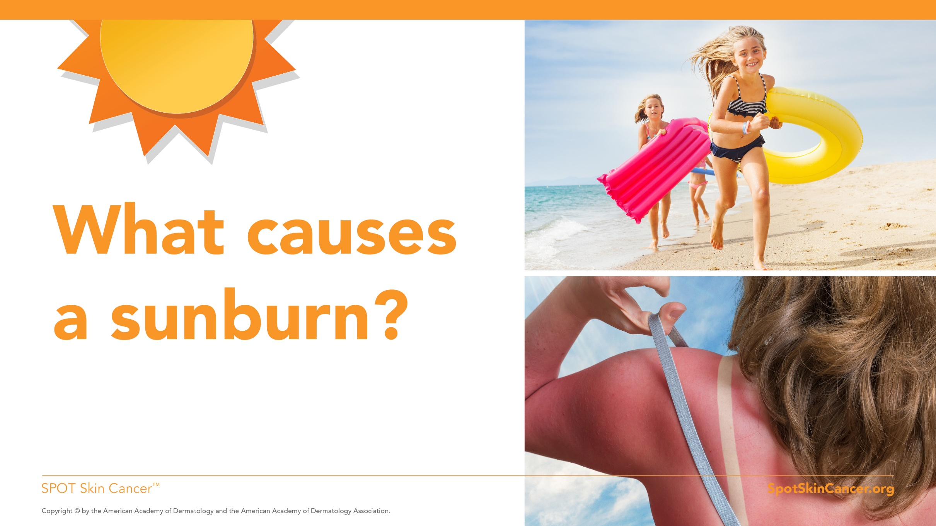
Notes:
How does your skin get sunburned anyway? The sun has two different kinds of invisible rays that reach the earth and damage your skin. These rays are dangerous and if your skin is exposed to these rays without protection, like wearing sunscreen or long-sleeved shirts, hats and pants, you can get a sunburn. Over time, if you continue to get too much sun without protection, you can develop dark spots, wrinkles and maybe a serious condition called skin cancer.

Slide 6
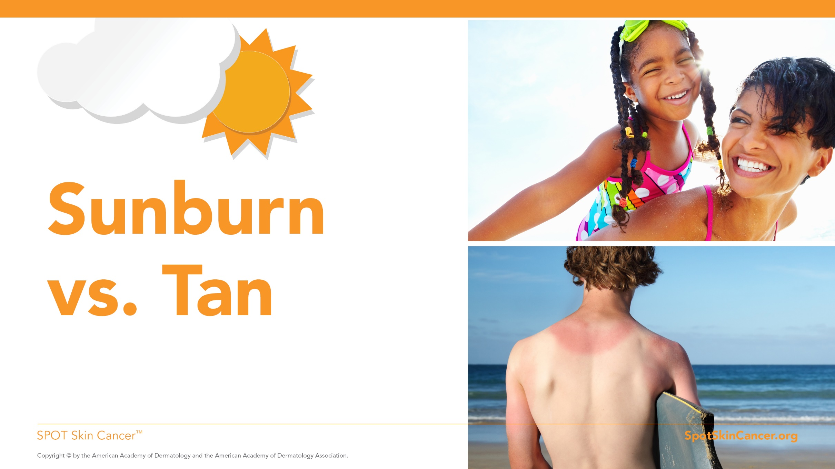
Notes:
Why does one person’s skin sunburn and someone else’s skin tans? You have something called melanin in your skin. It’s the stuff that gives your skin its color. People with dark skin have more melanin. People with light skin have less.
Your body makes melanin every day trying to protect the deeper layers of your skin from damage. When your skin gets damaged by the sun’s rays, it makes even more melanin to try and protect your skin from being damaged even more. That causes the skin to change color: Your dark-skinned friends will turn darker brown, or tan, when they go in the sun. Your light-skinned friends will turn red, or burn, when they go in the sun. Besides tanning or burning, a lot of people also get uneven patches of color or even freckles when they are in the sun too long.
Even if you have naturally dark skin or never burn and always tan, that still means the sun is damaging your skin.

Slide 7
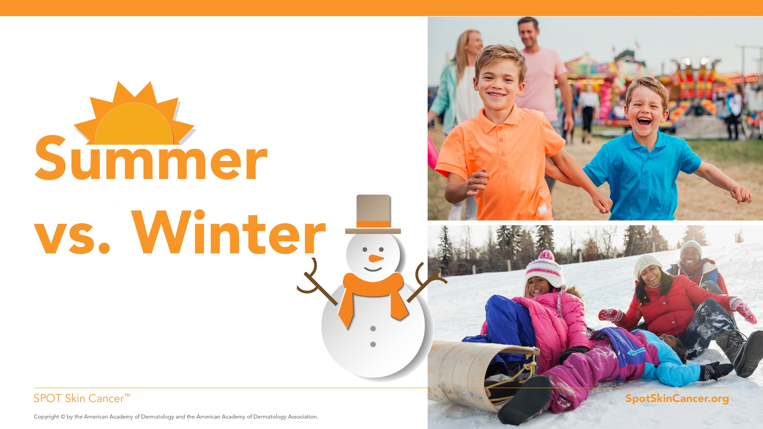
Notes:
Now we know how the sun damages your skin. But I’ll bet you didn’t know that summer is not the only time you have to think about the dangers of the sun. Remember, even during winter you can get sunburned, because the snow reflects the sun’s rays. In fact, skiers often get sunburned because the sun’s rays reflect off the snow.

Slide 8
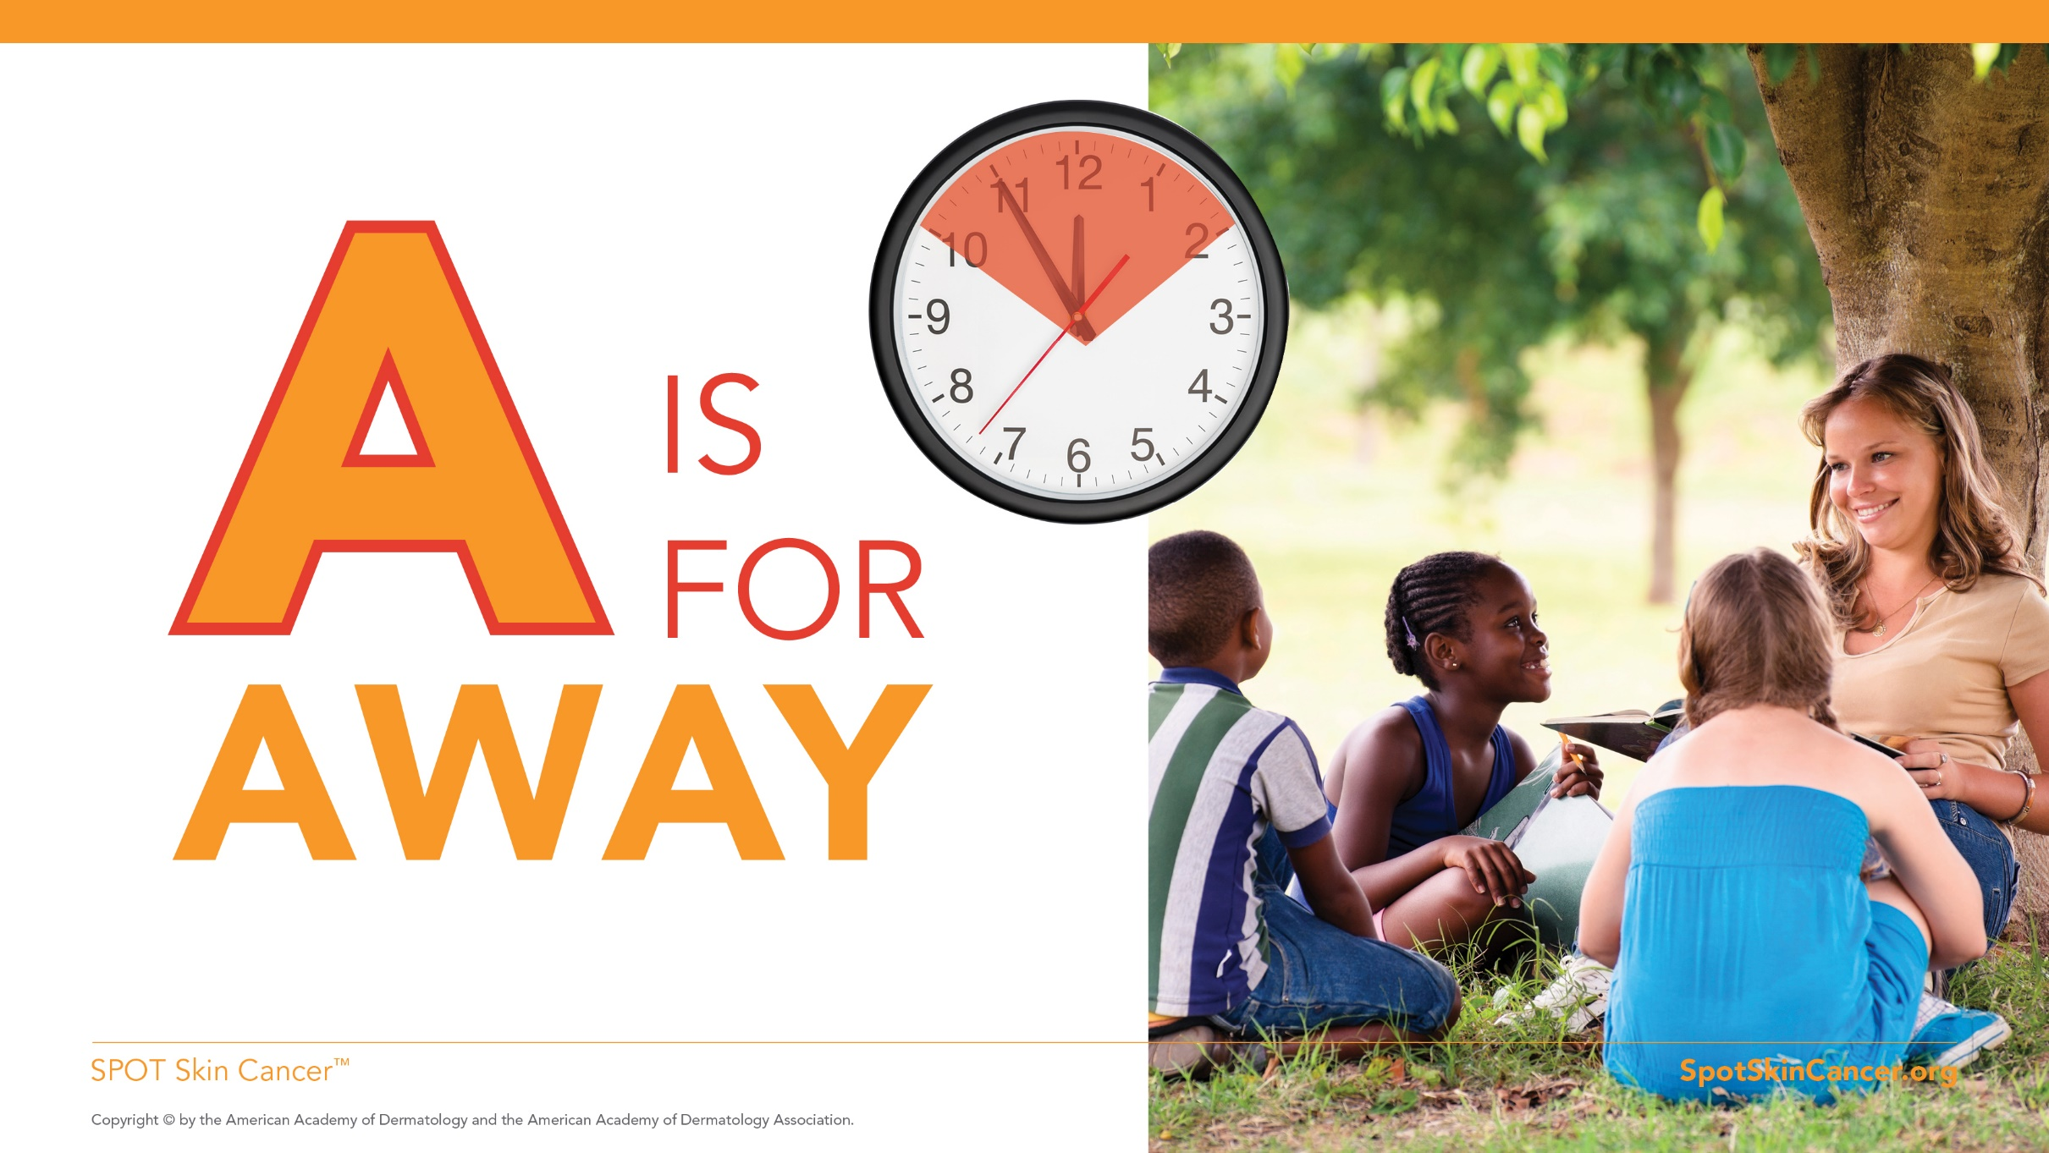
Notes:
So what’s the best way to protect yourself from the sun? Gigi says you should use your ABCs for safe fun in the sun.
A is for Away.
Look for shade between 10 a.m. and 2 p.m. because this is when the sun’s rays are the strongest. Have you ever looked at your shadow and noticed that it was long or short depending on the time of day? If your shadow is shorter than you are, it’s time to get away from the sun.

Slide 9
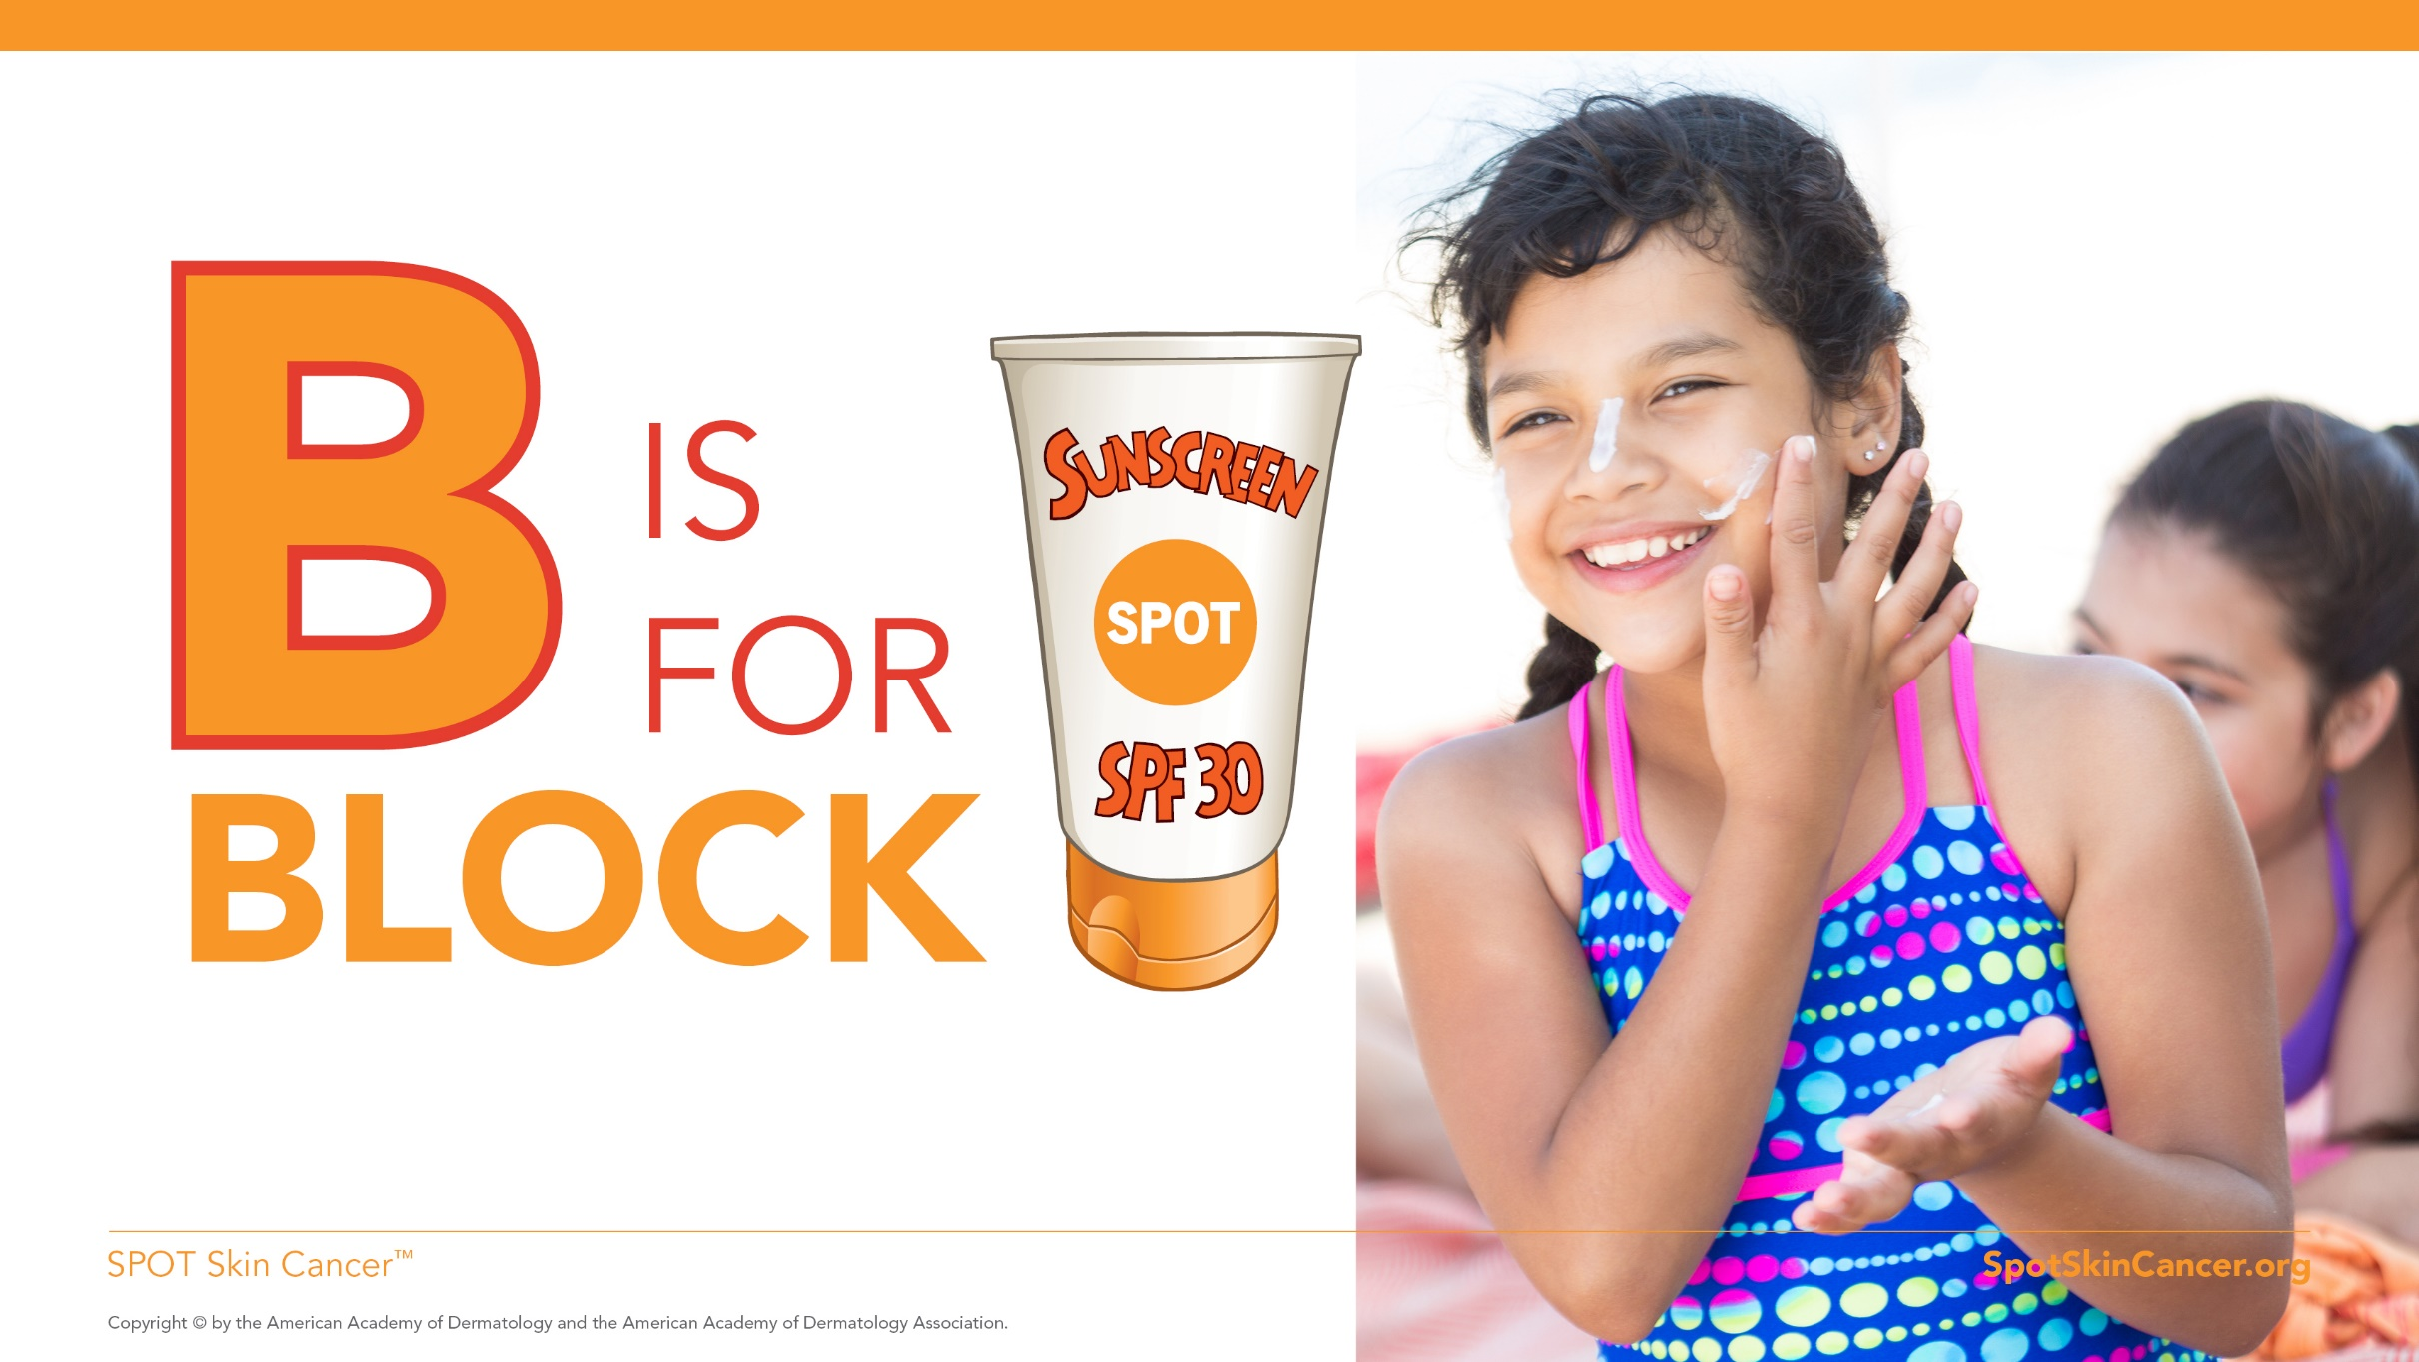
Notes:
B is for Block.
To block the sun, but not the fun, slather on sunscreen. Make sure you cover every inch of your skin that is not covered by clothing with sunscreen. Ask your parents or a friend to put sunscreen on those hard to reach areas and don’t forget your lips. Put on sunscreen 15 minutes before going outside. It only takes a few minutes.
Your parents can help you choose a sunscreen to protect you from the sun. Look for a sunscreen with an SPF number of 30 or higher. SPF stands for sun protection factor. It will say on the front of the bottle what the sunscreen’s SPF number is.
Sunscreen wears off, so put more on after swimming or sweating. Sunscreens rub and wash off, so if you’ve dried off with a towel, be sure to reapply your sunscreen.

Slide 10
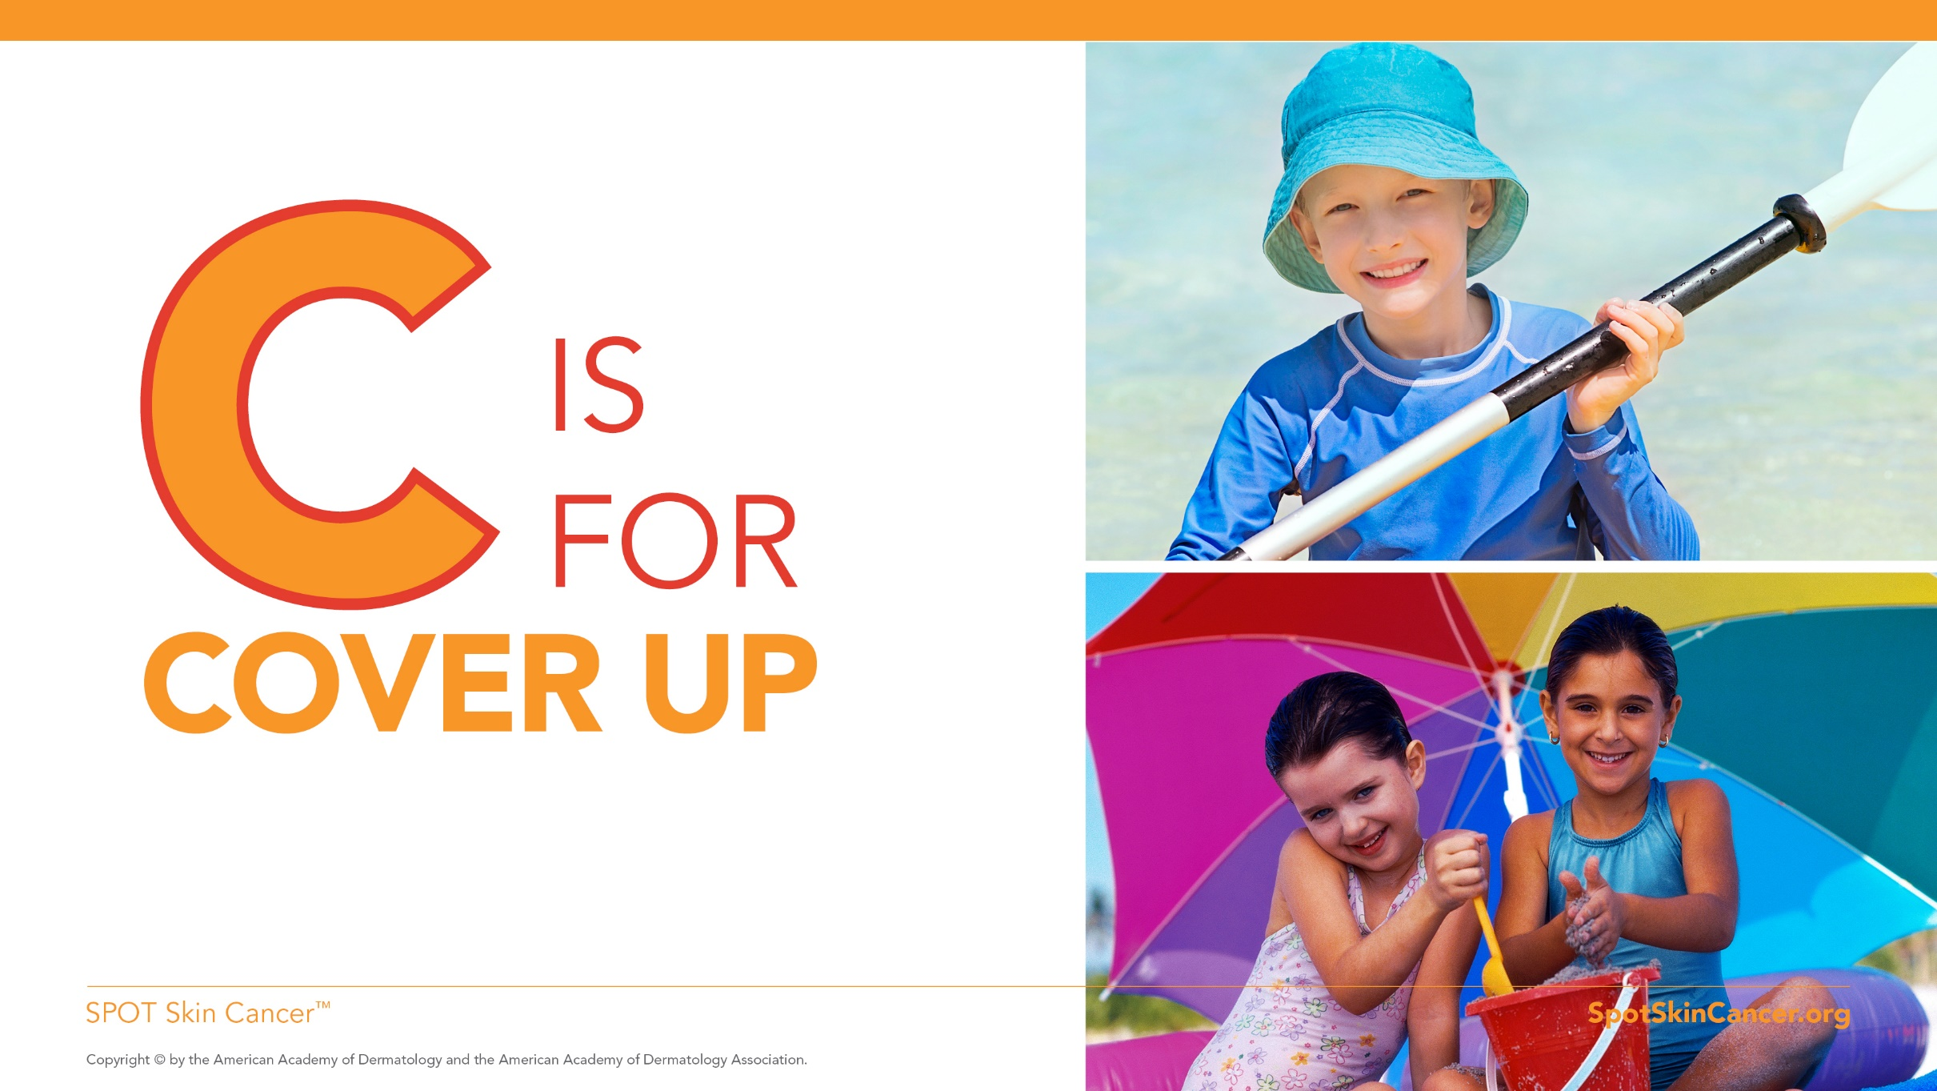
Notes:
C is for Cover up.
Long-sleeved shirts and pants can help keep the sun off your skin. Hats, especially those with a really large brim all the way around, more than a baseball cap, are great because they keep the sun off your face, ears and neck. Sunglasses protect your eyes and the skin near your eyes.
(NOTE to AAD members: Please bring examples of these items to show.)

Slide 11
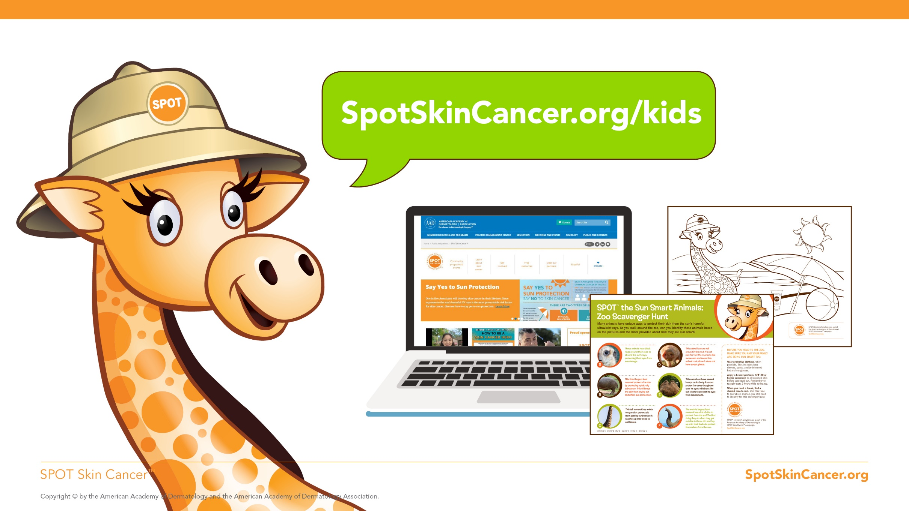
Notes:
To visit Gigi the Giraffe and learn more about how to protect yourself from the sun, ask your parents if you can visit www.SpotSkinCancer.org/kids. You can download fun activity sheets and learn more fun stuff.

Slide 12
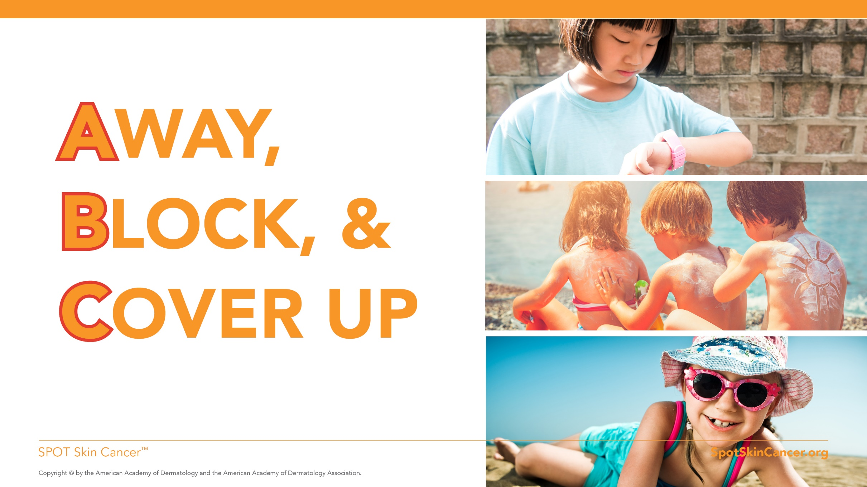
Notes:
I hope you enjoyed learning about the importance of being safe in the sun from Gigi. Remember the ABCs for safe fun in the sun. Now to help you remember to stay safe in the sun, the American Academy of Dermatology has provided you with some activity sheets featuring Gigi the giraffe to take home and share with your family. Then you can all stay safe in the sun together.
Thank you for your attention. I can answer any questions that you have?
Note to AAD member: Print out copies of the coloring sheets in advance to hand out. You can print from the following slides, or you can find them online in the Academy’s Children’s Toolkit: www.SpotSkinCancer.org/kids.

Slide 13
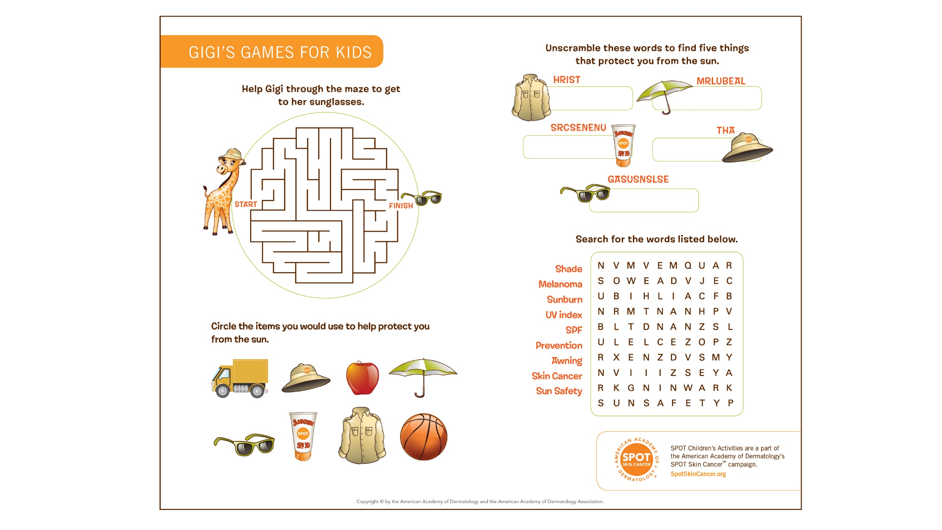

Slide 14
