Slide 1
www.fueleconomy.gov the official U.S. government source for fuel economy information
Gas Mileage Tips
Your Name
Month, Day, Year
Organization
Email

Slide 2
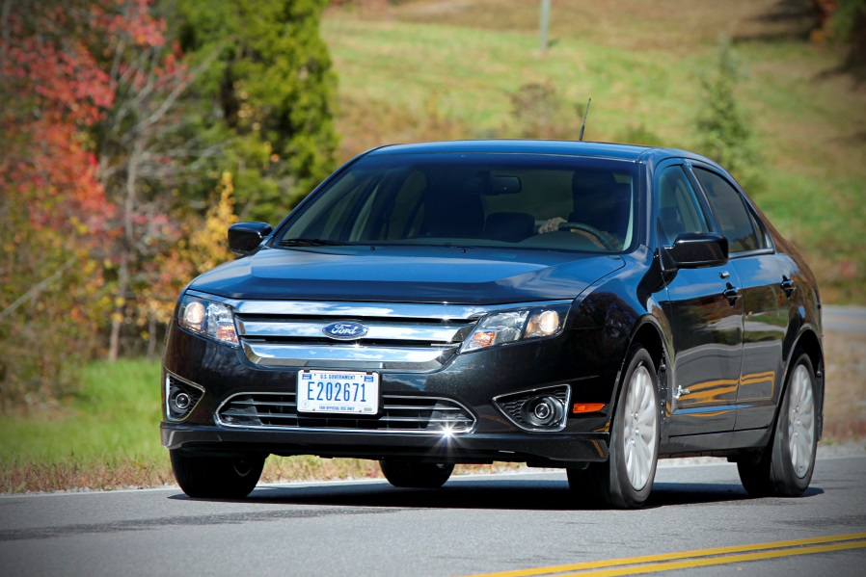
Gas Mileage Tips
A vehicle’s fuel economy can vary significantly depending on
  How it is driven
  Its mechanical condition
  The environment in which it is driven
Studies suggest the average driver can improve his/her fuel economy by roughly 10% by following a few simple gas saving tips.
Photo: Oak Ridge National Laboratory (2011-P061ORNL)

Slide 3
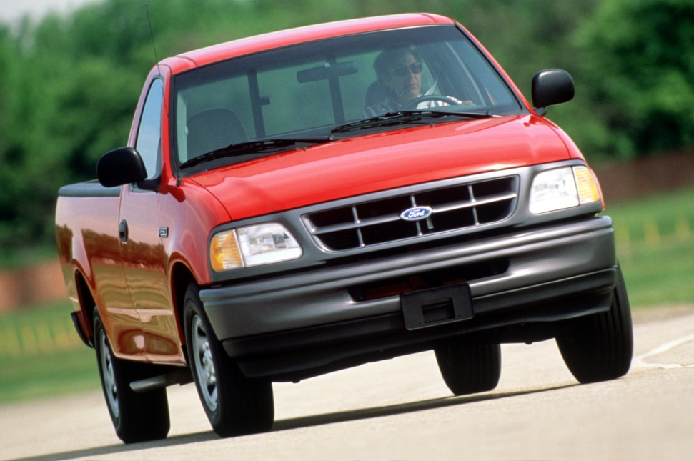
Gas Mileage Tips
Today’s presentation includes tips on
  Driving more efficiently
  Maintaining your car
  Planning and combining trips
  Maximizing fuel economy in hot and cold weather
  Improving the fuel economy of hybrids and plug-in cars
Photo : NREL Image Gallery (05556.JPG)

Slide 4
Drive Sensibly
Aggressive driving (speeding, rapid acceleration and braking) can lower your gas mileage by as much as 33% at highway speeds and by 5% around town.
  Anticipate traffic situations to avoid unnecessary acceleration.
  Accelerate smoothly at a moderate rate.
Fuel Economy Benefit: | 5% - 33%
Equivalent Gasoline Savings: | $0.14–$0.93/gallon
* Average savings based on a fuel price of $2.83 per gallon
Notes:
Sensible driving is also safer, so you may save more than money.
Research has shown that using a driver feedback device can help you improve fuel economy by up to 10%.

Slide 5
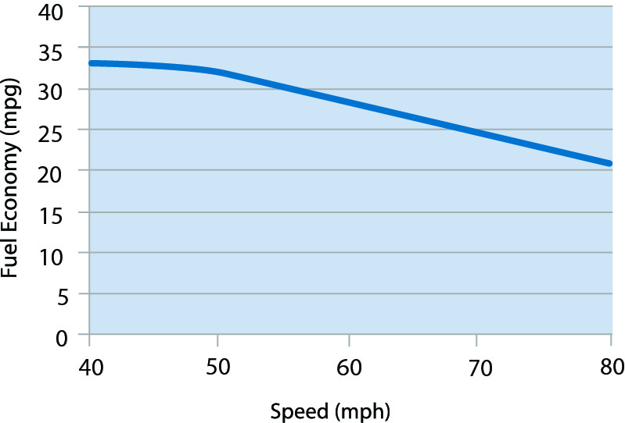
Observe the Speed Limit
While each vehicle reaches its optimal fuel economy at a different speed (or range of speeds), gas mileage usually decreases rapidly at speeds above 50 mph.
Fuel Economy Benefit: | 7% - 14%
Equivalent Gasoline Savings*: | $0.20–$0.40/gallon
Notes:
You can assume that each 5 mph you drive over 50 mph is like paying an additional $0.16 per gallon for gas.
Observing the speed limit is also safer.
*Average savings, assuming drivers are willing to slow down 5 to 10 mph and fuel costs $2.83 per gallon

Slide 6
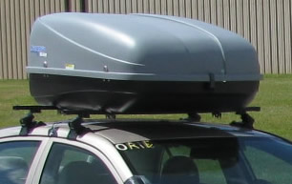
Avoid Hauling Cargo on Your Roof
Hauling cargo on your roof increases aerodynamic drag (wind resistance) and lowers fuel economy.
  If you need to use an external cargo container, removing it when it's not in use will save fuel and money.
Fuel Economy Benefit: | 2% - 17%
Equivalent Gasoline Savings: | $0.06–$0.48/gallon
* Average savings based on a fuel price of $2.83 per gallon
Notes:
A large, blunt roof-top cargo box, for example, can reduce fuel economy by around 2% to 8% in city driving, 6% to 17% on the highway, and 10% to 25% at Interstate speeds (65 mph to 75 mph).⁴
Rear-mount cargo boxes or trays reduce fuel economy by much less—only 1% or 2% in city driving and 1% to 5% on the highway.

Slide 7
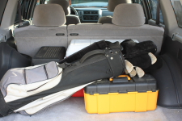
Remove Excess Weight
Avoid keeping unnecessary items in your vehicle, especially heavy ones.
  An extra 100 pounds in your vehicle could reduce your MPG by about 1%.
Fuel Economy Benefit: | 1% per 100 lbs.
Equivalent Gasoline Savings: | $0.03/gallon
* Average savings based on a fuel price of $2.83 per gallon
Notes:
Note: The reduction is based on the percentage of extra weight relative to the vehicle's weight and affects smaller vehicles more than larger ones.

Slide 8

Avoid Excessive Idling
Idling can use a quarter to a half gallon of fuel per hour, depending on engine size and air conditioner (AC) use.
  Turn off your engine when your vehicle is parked.
  It only takes about 10 seconds worth of fuel to restart your vehicle.
Notes:
If you'd like to promote idle reduction in your area, the Clean Cities IdleBox Toolkit can help you get started.

Slide 9
Avoid Excessive Idling
Idling Best Practices
  Limit engine starts to about 10 times per day on average—unless your vehicle is equipped with a start-stop system. Occasionally exceeding this limit should not cause excessive starter wear.
  Assuming 10 starts a day aren't exceeded, any shutdown longer than 1 minute will save money.
  Limit electric accessory use during shutdown, particularly during longer shutdown periods.
  Drive at least 5 miles between start cycles to fully recharge the battery.
Notes:
If you'd like to promote idle reduction in your area, the Clean Cities IdleBox Toolkit can help you get started.

Slide 10
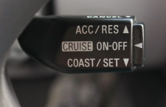
Use Cruise Control
Using cruise control on the highway helps you maintain a constant speed and, in most cases, will save gas.

Slide 11
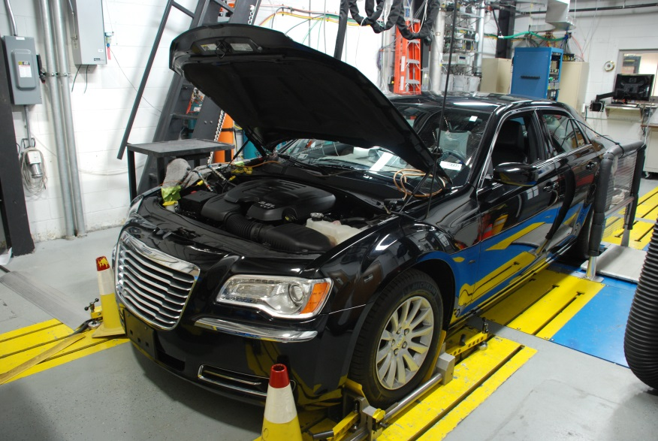
Keep Your Engine Properly Tuned
Fixing a car that is noticeably out of tune or has failed an emissions test can improve its gas mileage by an average of 4%, though results vary based on the kind of repair and how well it is done.
Fuel Economy Benefit: | 4%
Equivalent Gasoline Savings: | $0.11/gallon
* Average savings based on a fuel price of $2.83 per gallon
Notes:
Fixing a serious maintenance problem, such as a faulty oxygen sensor, can improve your mileage by as much as 40%.

Slide 12
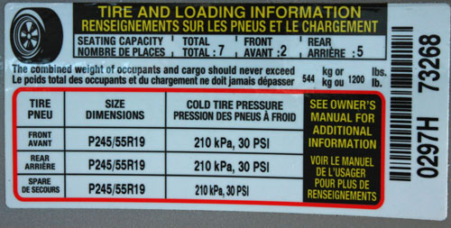
Keep Tires Properly Inflated
You can improve your gas mileage by 0.6% on average—up to 3% in some cases—by keeping your tires inflated to the proper pressure.
  Under-inflated tires can lower gas mileage by about 0.2% for every 1 psi drop in the average pressure of all tires.
  Properly inflated tires are safer and last longer.
Fuel Economy Benefit: | 0.6%
Equivalent Gasoline Savings: | $0.02/gallon
* Average savings based on a fuel price of $2.83 per gallon
Notes:
Note: The proper tire pressure for your vehicle is usually found on a sticker in the driver's side door jamb or the glove box and in your owner's manual. Do not use the maximum pressure printed on the tire's sidewall.

Slide 13
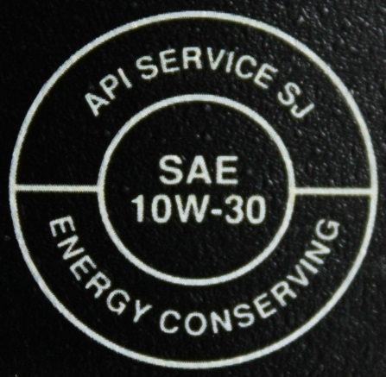
Use the Recommended Grade of Motor Oil
You can improve your gas mileage by 1%–2% by using the manufacturer's recommended grade of motor oil.
  For example, using 10W-30 motor oil in an engine designed to use 5W-30 can lower your gas mileage by 1%–2%.
  Using 5W-30 in an engine designed for 5W-20 can lower your gas mileage by 1%–1.5%.
  Also, look for motor oil that says "Energy Conserving" on the API performance symbol to be sure it contains friction-reducing additives.
Fuel Economy Benefit: | 1% - 2%
Equivalent Gasoline Savings: | $0.03–$0.06/gallon
* Average savings based on a fuel price of $2.83 per gallon

Slide 14
Planning and Combining Trips
Combining errands into one trip saves you time and money.
  Your fuel economy is worse when your engine is cold than when it is warmed up.
  Several short trips taken from a cold start can use twice as much fuel as a longer, multipurpose trip covering the same distance.
  Trip planning can also reduce the distance you travel.
  Consider walking or biking if possible.

Slide 15
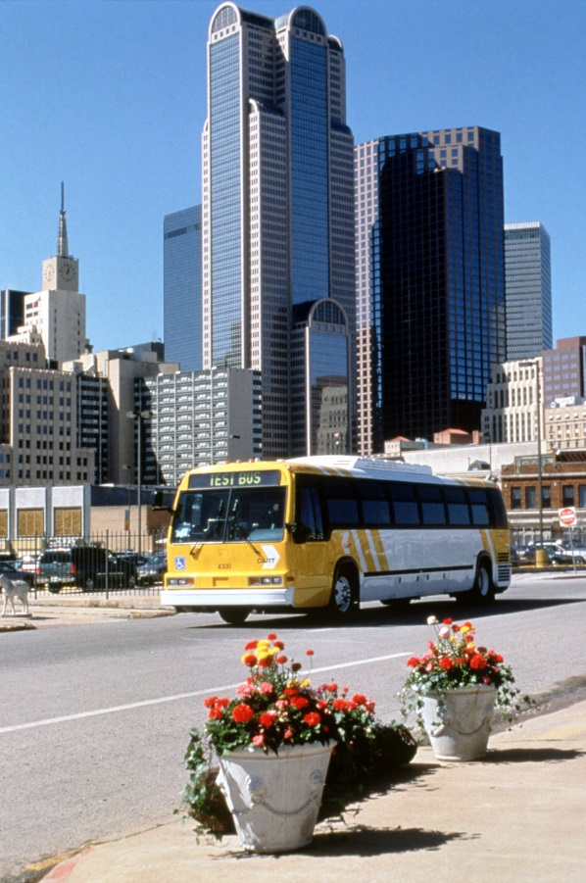
Commuting
Stagger your work hours to avoid peak rush hours.
Drive your most fuel-efficient vehicle.
Work from home if your employer permits it.
Take advantage of carpools and ride-share programs.
Consider using public transit if it is available and convenient for you.
Photo: National Renewable Energy Laboratory (09147)
Notes:
Many urban areas allow vehicles with multiple passengers to use High Occupancy Vehicle (HOV) lanes.
HOV lanes are typically less congested, further improving your fuel economy.

Slide 16
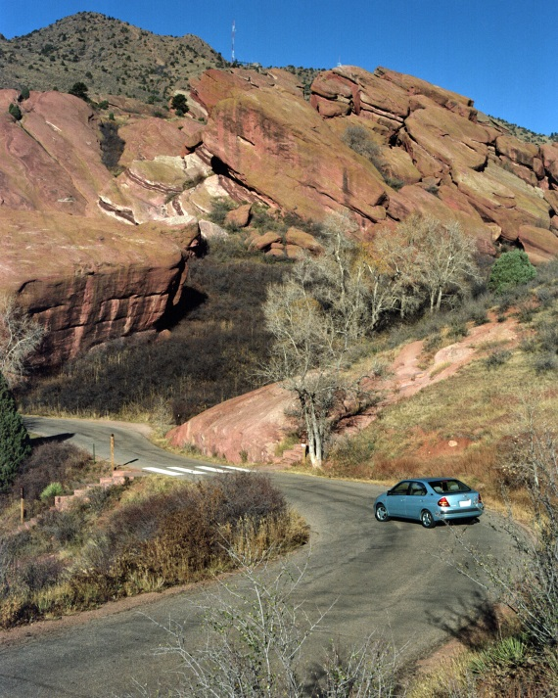
Fuel Economy in Hot Weather
Hot weather can actually increase your fuel economy.
Your engine warms up to an efficient temperature faster
Summer grades of gasoline can have slightly more energy
Warm air causes less aerodynamic drag than cold air.
However, keeping passengers comfortable in hot weather by rolling down the windows or using the air conditioning (AC) can reduce fuel economy.
Photo: National Renewable Energy Laboratory (08401)

Slide 17
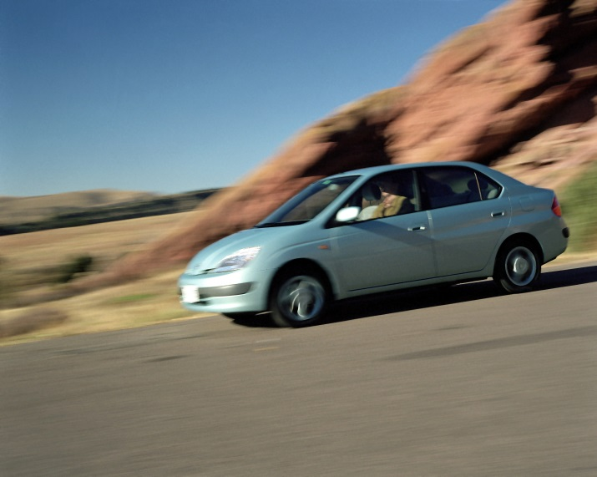
Fuel Economy in Hot Weather (continued)
What can I do to improve my fuel economy in hot weather?
  Roll the windows down at lower speeds; use the AC at highway speeds.
  Don't use the AC more than needed or set the temperature lower than needed.
  Park in the shade or use a sunshade so that the cabin doesn't get as hot.
  Drive with the windows open for a short time before using the AC.
Photo: National Renewable Energy Laboratory (08401)
Notes:
Letting hot air out of the cabin first will put less demand on the AC and help your vehicle cool faster.

Slide 18
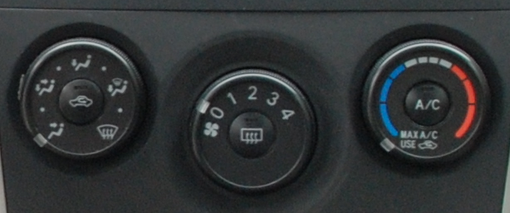
Fuel Economy in Hot Weather (continued)
What can I do to improve my fuel economy in hot weather?
  Don't idle with the AC running before driving.
  Read your owner's manual. Most manuals explain how the AC system controls work and how to best use and maintain the AC system.
  For plug-in hybrids and electric vehicles, pre-cooling the cabin while plugged into the charger can extend your vehicle's range. Also, using a warmer temperature setting for the AC will use less battery power.
Notes:
Turn the AC on after you begin to drive or after airing out the cabin briefly. Most AC systems will cool the vehicle faster while driving.

Slide 19
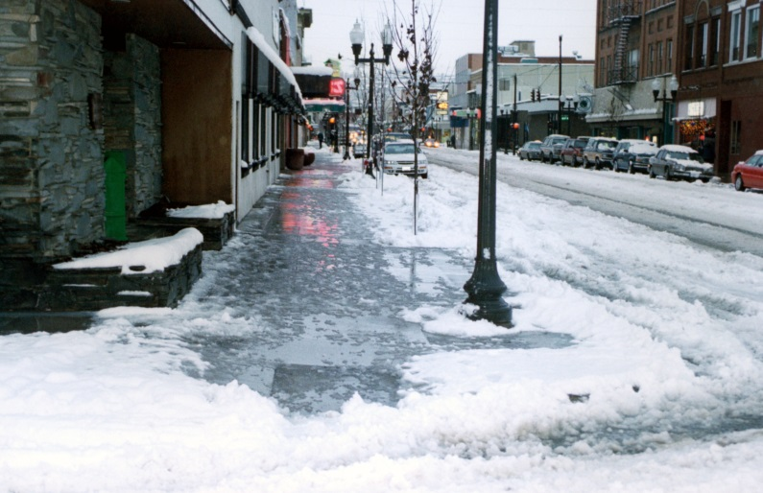
Fuel Economy in Cold Weather
Cold weather and winter driving conditions can reduce your fuel economy significantly.
Fuel economy tests show that, in short-trip city driving, a conventional gasoline car's gas mileage is about 12% lower at 20°F than it would be at 77°F. It can drop as much as 22% for very short trips (3 to 4 miles).
The effect on hybrids is worse. Their fuel economy can drop about 31% to 34% under these conditions.
Photo: National Renewable Energy Laboratory (08829NREL)

Slide 20
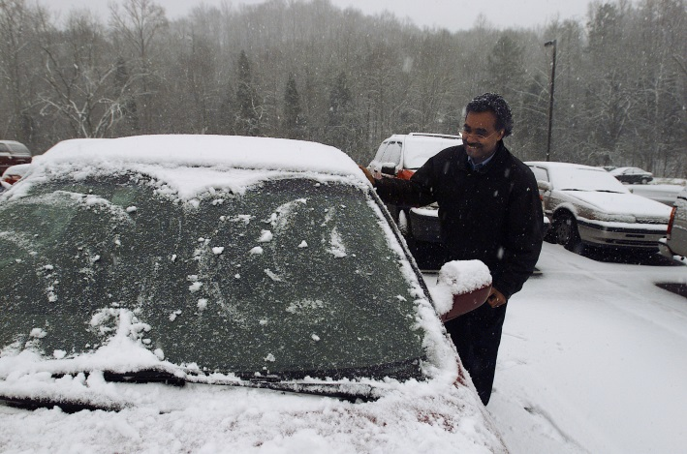
Fuel Economy in Cold Weather
What can I do to improve my fuel economy in cold weather?
  Park your car in a warmer place, such as your garage, to increase the initial temperature of your engine and cabin.
  Combine trips when possible so that you drive less often with a cold engine.
  Minimize idling your car to warm it up.
  Don't use seat warmers or defrosters more than necessary.
Photo: Oak Ridge National Laboratory (191-2003ORNL)
Notes:
Minimize Idling:
Most manufacturers recommend driving off gently after about 30 seconds.
The engine will warm up faster being driven, which will allow the heat to turn on sooner, decrease your fuel costs, and reduce emissions.

Slide 21
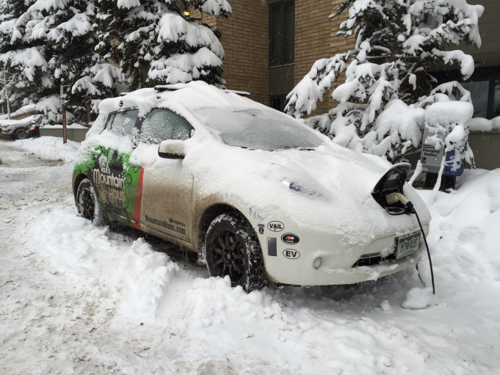
Fuel Economy in Cold Weather (continued)
What can I do to improve my fuel economy in cold weather?
  Check your tire pressure regularly.
  Use the type of oil recommended by your manufacturer for cold weather driving.
  Remove accessories that increase wind resistance, like roof racks, when not in use.
  If you drive a plug-in hybrid or electric vehicle, preheating the cabin while plugged into the charger can extend your vehicle's range.
  If you drive a plug-in hybrid or electric vehicle, using the seat warmers instead of the cabin heater can save energy and extend range.
Photo: National Renewable Energy Laboratory (35690NREL)

Slide 22
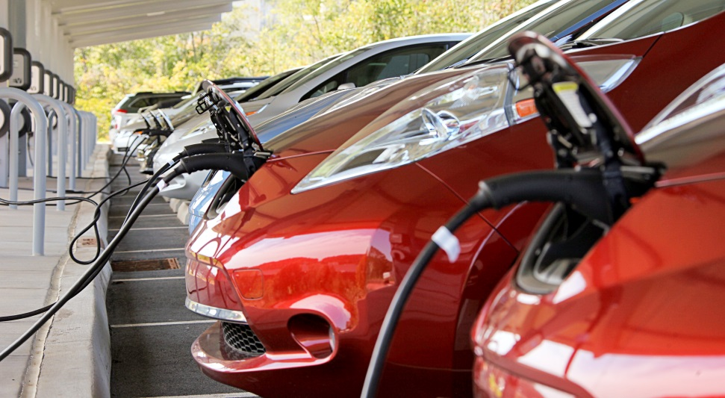
Tips for Hybrids, Plug-in Hybrids, and Electric Vehicles
Many of the gas-saving tips for conventional vehicles also apply to hybrids, plug-in hybrids, and all-electric vehicles (EVs). Here are some additional tips that may help you improve the fuel economy of these advanced vehicles.
Photo: Oak Ridge National Laboratory (2011-P03692)

Slide 23

Tips for Hybrids, Plug-in Hybrids, and Electric Vehicles
Read the Owner’s Manual
  These vehicles can vary significantly in design, especially the way they manage energy use. Tips that apply to one model may not apply to another.
  The automaker knows how to operate and maintain your vehicle to maximize fuel economy, driving range, and battery life. Consult your owner’s manual for tips specific to your vehicle.

Slide 24
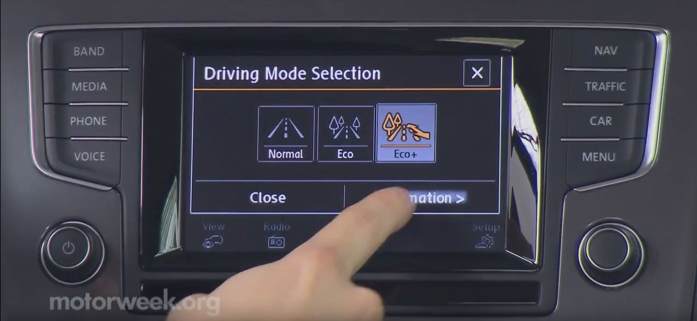
Tips for Hybrids, Plug-in Hybrids, and Electric Vehicles (continued)
Avoid Hard Braking
  Anticipate stops and brake gently or moderately.
Use the Economy Mode
  Many of these vehicles come with an "economy mode" or similar feature to improve fuel economy.
  You can often turn on this feature by just pressing a button.
Notes:
Avoid Hard Braking (notes):
This allows the regenerative braking system to recover energy from the vehicle's forward motion and store it as electricity.
Hard braking causes the vehicle to use its conventional friction brakes, which do not recover energy.

Slide 25
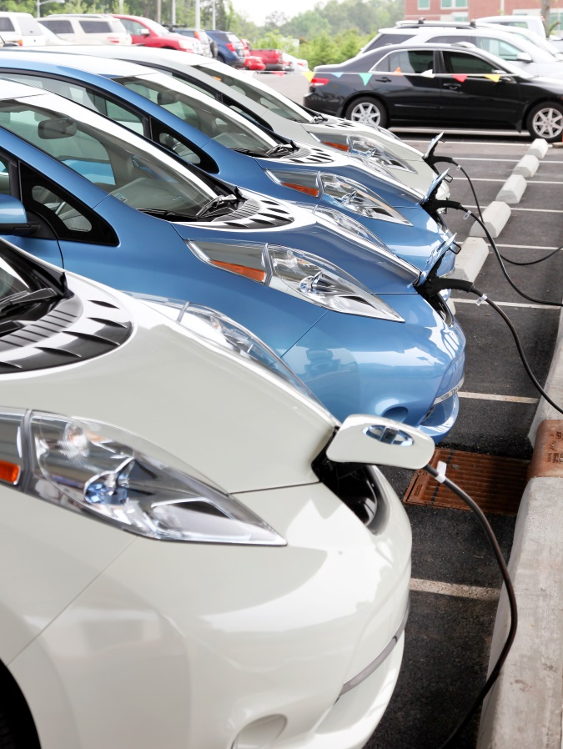
Tips for Hybrids, Plug-in Hybrids, and Electric Vehicles (continued)
Keep the Battery Charged
(EVs and Plug-in Hybrids Only)
  For plug-in hybrids, keeping the battery charged helps you use as much electricity and as little gasoline as possible, saving you fuel and money.
  For EVs, it helps maximize your driving range.
Use Accessories Wisely
  Using accessories such as heating, air conditioning, and entertainment systems can lower fuel economy on all vehicles, but they can have a greater effect on hybrids and electrics.
  Pre-heating or pre-cooling the cabin of a plug-in hybrid or EV while it's plugged in, for example, can extend its electric range.
Photo: Oak Ridge National Laboratory (2011-P01919)
Notes:
Notes: Check your owner manual for the best charging advice for your vehicle.

Slide 26
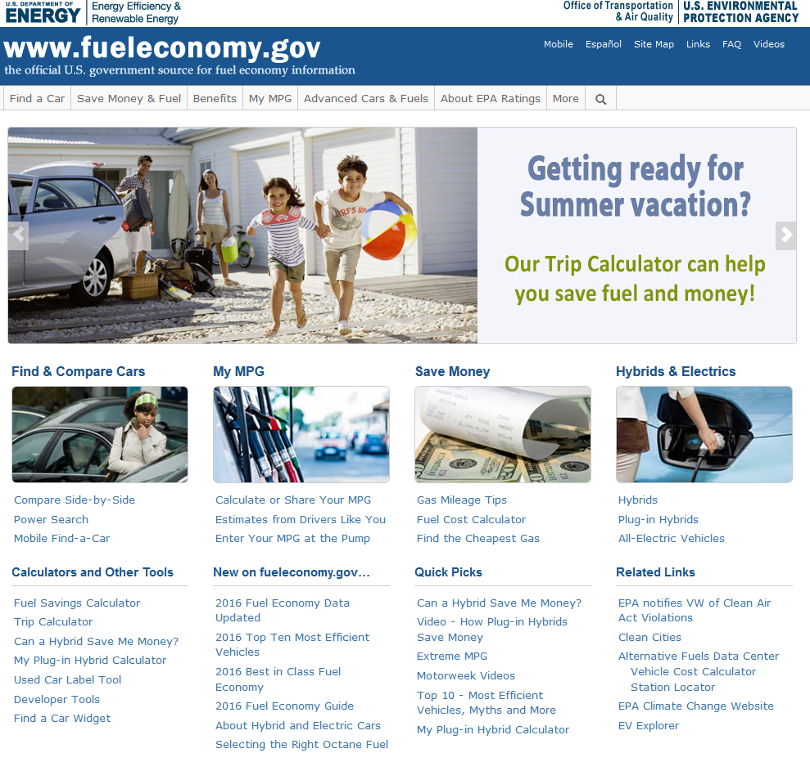
Choosing a More Efficient Vehicle
Fueleconomy.gov has gas mileage estimates and other information for cars from the current model year back to 1984.
  Selecting which vehicle to purchase is the most important fuel economy decision you'll make.
  The difference between a car that gets 20 MPG and one that gets 30 MPG amounts to $708 per year
  That's $3,538 extra in fuel costs over five years!
* Assuming 15,000 miles of driving annually and a fuel cost of $2.83 per gallon

Slide 27
Data Sources
Estimates for fuel savings from sensible driving are based on Energy and Environmental Analysis, Inc., Owner Related Fuel Economy Improvements, Arlington, Virginia, 2001.
Institute of Transportation Studies, University of California, Davis. ECODRIVE I-80: A Large Sample Fuel Economy Feedback Field Test (ITS-RR-13-15).
Estimates for the effect of speed on MPG are based on a study by Oak Ridge National Laboratory (ORNL): Predicting Light-Duty Vehicle Fuel Economy as a Function of Highway Speed, SAE 2013-01-1113.
Oak Ridge National Laboratory. 2014. Fuel Economy and Emissions Effects of Low Tire Pressure, Open Windows, Roof Top and Hitch-Mounted Cargo, and Trailer (SAE 2014-01-1614). Study results are based on testing with a small sedan, a standard size SUV, a single roof-top cargo box (20" H x 40" W x 50" L), and a single rear-mount cargo tray. Cargo boxes with other dimensions or shapes may have a different effect on fuel economy.
Based on a fuel economy improvement of 0.33% per 1% reduction in weight as estimated by Ricardo Inc., Impact of Vehicle Weight Reduction on Fuel Economy for Various Vehicle Architectures, April 2008. Our estimate assumes a vehicle weight, including cargo, of 3,200 lbs.
Argonne National Laboratory. 2015. Stop and Restart Effects on Modern Vehicle Starting System Components – Longevity and Economic Factors.
Estimates for fuel savings from vehicle maintenance, keeping tires properly inflated, and using the recommended grade of motor oil based on Energy and Environmental Analysis, Inc., Owner Related Fuel Economy Improvements, Arlington, Virginia, 2001.
Thomas, J., West, B., Huff, S. 2013. Effect of Air Filter Condition on Diesel Vehicle Fuel Economy. SAE Technical Paper 2013-01-0311.
Thomas, J., West, B., Huff, S., and Norman, K. 2012. Effect of Intake Air Filter Condition on Light-Duty Gasoline Vehicles. SAE Technical Paper 2012-01-1717.
Norman, K., Huff, S., and West, B. 2009. Effect of Intake Air Filter Condition on Vehicle Fuel Economy. ORNL/TM-2009/021. Oak Ridge National Laboratory.
Rask, E., D. Santini, and H. Lohse-Busch. 2013. Analysis of Input Power, Energy Availability, and Efficiency during Deceleration for X-EV Vehicles. SAE Int. J. Alt. Power. 2(2):350-361. DOI:10.4271/2013-01-1473.
Lohse-Busch, H., M. Duoba, E. Rask, and M. Meyer. 2012. Advanced Powertrain Research Facility AVTA Nissan Leaf Testing and Analysis. Argonne National Laboratory.
Lohse-Busch, H., M. Duoba, E. Rask, K. Stutenberg, et al. 2013. Ambient Temperature (20°F, 72°F and 95°F) Impact on Fuel and Energy Consumption for Several Conventional Vehicles, Hybrid and Plug-In Hybrid Electric Vehicles and Battery Electric Vehicle. SAE Technical Paper 2013-01-1462. DOI:10.4271/2013-01-1462.
Estimates of the effect of cold temperatures on fuel economy are based on an analysis by Oak Ridge National Laboratory. The analysis compared EPA Federal Test Procedure results for 600 conventional vehicles and 14 hybrids under "normal" temperatures (around 77°F) to the results under cold-weather conditions (20°F).
Huff S.P., B.H. West, and J.F. Thomas. 2013. Effects of Air Conditioner Use on Real-World Fuel Economy. SAE paper 2013-01-0551 (doi: 10.4271/2013-01-0551). SAE 2013 World Congress, Detroit, Michigan, April 2013.
Lohse-Busch, H., M. Duoba, E. Rask, K. Stutenberg, V. Gowri, L. Slezak, and D. Anderson. 2013. Ambient Temperature (20°F, 72°F and 95°F) Impact on Fuel and Energy Consumption for Several Conventional Vehicles, Hybrid and Plug-In Hybrid Electric Vehicles and Battery Electric Vehicle. SAE Technical Paper 2013-01-1462 (doi:10.4271/2013-01-1462).
Thomas, J.F., S.P. Huff, and B.H. West. 2014. Fuel Economy and Emissions Effects of Low Tire Pressure, Open Windows, Roof Top and Hitch-Mounted Cargo, and Trailer. SAE Int. J. Passeng. Cars - Mech. Syst. 7(2):2014 (doi:10.4271/2014-01-1614).
Furse, D., S. Park, L. Foster, and S. Kim. 2014. Real World Customer Usage of the Hyundai Genesis Climate Control System in the USA. SAE Technical Paper 2014-01-0685 (doi:10.4271/2014-01-0685).

